Slide 1
11/18/22

Slide 2
Unit 5 Review

Slide 3
5.1
Anatomy of a Java Class

Slide 4
Definitions
Class - Blueprint for an object; instructions for how construct an object. There can be ONLY ONE of these -> "Dog"
Object - A particular instance of a class; use the new operator to create an object instance from a Class. There can be MANY of these -> "A 3 year-old German Shepherd named Roscoe", "A 1 year-old Golden Retriever named Lucy"
Properties and Methods - Properties are attributes (name, age, breed) and Methods are operations (play, eat, sleep); and each can be either public (available outside the Object) or private (available from only the inside of an Object)

Slide 5
Instance Variables
Also known as attributes, properties, or fields
Holds the data of an object
Every Object instance has their own values for these properties
Dog scout = new Dog("Scout", 10); Dog bailey = new Dog("Bailey", 5);
scout.name.equals("Scout") == true bailey.name.equals("Bailey") == true scout.name.equals(bailey.name) == false

Slide 6
Instance Methods
Define the behavior generically in the Class
So that it can be used by every Object instance
public void feedDog() { System.out.println("Gave " + name + " a bowl of food."); }
Dog scout = new Dog("Scout", 10); Dog bailey = new Dog("Bailey", 5);
scout.feedDog(); "Gave Scout a bowl of food." bailey.feedDog(); "Gave Bailey a bowl of food."

Slide 7
Private vs Public
Private
An instance variable or method that can only be accessed within the class
On the AP Exam all instance variables should be private
Some methods can be private if they are only used internally
Public
An instance variable or method that can be accessed outside of a class like in the main method
Most methods are public

Slide 8
Object-Oriented Design
A design philosophy used by programmers when developing larger programs
Decide what classes you’ll need to solve a problem
Define the data (instance variables) and functionality (methods) for the classes
Utilize classes and objects to solve your problem

Slide 9

Data Encapsulation
Data (instance variables) and the code acting on it (methods) are wrapped together in a single implementation and the details are hidden.
Data is safe from harm by keeping it private

Slide 10
5.2 & 5.3
Constructors, Comments, and Conditions

Slide 11
The Anatomy of a Constructor
Things to keep in mind:
The Constructor name (in red) must always match the name of the class (in blue)
Always prepend the public keyword before your constructor name
Constructors have no return type. Not even void!
The constructor definition is often included before other method definitions (but is not required)
public class ClassName { // Instance Variable Declarations // Constructor - same name as Class, no return type public ClassName() { // Implementation not shown } // Other methods ... }

Slide 12
Instance Variable Initialization
Instance Variables are properties of your class (name, age, and isAlive in this example)
They are normally given initial values within your Constructor
They can also be defined in place (i.e. private boolean isAlive = true;)
public class Person { private String name; private int age;
private boolean isAlive = true;
public Person(String initName, int initAge) { name = initName; age = initAge; } }

Slide 13
Types of Constructors
Default Constructor
No-Argument Constructor
Parameterized Constructor
Overloaded Constructors
Automatically generated by the Java compiler when you do not supply a Constructor
Does not do any kind of specialized initialization of the Instance beyond whatever inplace variable initialization that exists
Instance variables without inplace initialization will default to something "reasonable"
int -> 0
boolean -> false
String -> null
Object -> null
public class Person {
// No constructor defined
// Java creates Default Constructor
}

Slide 14
Types of Constructors
Default Constructor
No-Argument Constructor
Parameterized Constructor
Overloaded Constructors
A Constructor you define that takes no arguments
Can perform any kind of initialization that the the Instance requires
Every Instance is initialized exactly the same
No values can be passed in during new to customize the Instance
public class Person
{
private String name;
private int age;
public Person() {
name = "Billy";
age = 25;
}
}
When you define a Constructor (any kind) Java will NOT create a Default Constructor!

Slide 15
Types of Constructors
Default Constructor
No-Argument Constructor
Parameterized Constructor
Overloaded Constructors
A Constructor you define that takes arguments
Can perform any kind of initialization that the the Instance requires
Each Instance is initialized individually based on the values passed into new
public class Person
{
private String name;
public Person(String initName) {
name = initName;
}
}

Slide 16
Types of Constructors
Default Constructor
No-Argument Constructor
Parameterized Constructor
Overloaded Constructors
A Class may have multiple Constructors
Each Constructor must be named the same as the Class; have no return type; and have a distinct set of parameters (types)
These are useful when you want to provide default values for some Instance variables - While allowing other Instance variables to be set via new
public class Person
{
private String name;
private int age;
public Person() {
name = "Name unknown"; }
public Person(String initName) {
name = initName;
age = 30;
}
public Person(String initName, int initAge) {
name = initName;
age = initAge;
}
}

Slide 17


Slide 18
Comments
Comments are a way for you to annotate your code
This is text in your program that is never run by Java and is added for the benefit of the person reading the code
You can also "comment out" a block of code during development to assist in the development or debugging process
There are 3 ways to write comments in Java

Slide 19
Types of Comments
Single-Line Comment
Multi-Line Comment
Documentation Comment
A single-line comment starts with a double forward-slash (//)
Can start anywhere - i.e. does not need to be in column 0
All characters following the double forward-slash are ignored until newline or end of file thisCodeWillRun(); // thisCodeWillNotRun(); thisCodeWillRun(); thisCodeWillRun(); // woo-hoo!

Slide 20
Types of Comments
A multi-line comment starts with a forward-slash asterisk (/*)
Can begin anywhere - i.e. does not need to be in column 0
All characters - including newlines - are considered part of the comment until a asterisk forward-slash (*/) is encountered
Your editor may have a key command that automatically converts a block of code into a multi-line comment /* thisCodeWillNotRun(); thisCodeWillNotRun(); */
/* thisCodeWillNotRun(); */ thisCodeWillRun(); /* woo-hoo! */
Single-Line Comment
Multi-Line Comment
Documentation Comment

Slide 21
Types of Comments
A variant of the multi-line comment syntax - Documentation Comments start with a forward-slash asterisk asterisk (/**)
Typically found just prior to the definition of a function or method
All characters - including newlines - are considered part of the Documentation Comment until a asterisk forward-slash (*/) is encountered
Within a Documentation Comment - other standard components may be supported /** * Documentation comment * */ myMethod()
Single-Line Comment
Multi-Line Comment
Documentation Comment

Slide 22
Preconditions and Postconditions
DEFINITELY on AP exam

Slide 23
Preconditions and Postconditions
Preconditions and postconditions are a "contract" that describes what a method requires about its inputs, and what it promises as output.
Precondition
Postcondition
index must be >= 0
and < length of string
public char charAt(int index);
character at index index will be returned
The caller must satisfy this requirement when calling charAt.
In return, the desired character will be returned.

Slide 24
Preconditions
Preconditions are part of the method's documentation, and may exist only as comments.
There is no expectation that the method will check to ensure preconditions are satisfied.
They may or may not be enforced by the method's code – the programmer using the method should read the documentation and understand the "contract" the method offers.
/**
* Precondition: num2 is not zero.
* Postcondition: Returns the quotient of num1 and num2.
*/
public double divide(double num1, double num2)
{
return num1 / num2;
}

Slide 25
Who enforces preconditions?
Sometimes preconditions ARE enforced by the method's code.
An actual implementation of Java's String.charAt:
Here, an exception is thrown if the precondition is not satisfied.
Throwing an exception in Java is a common way to handle failed preconditions.
public char charAt(int index) { if ((index < 0) || (index >= value.length)) { throw new StringIndexOutOfBoundsException(index); } return value[index]; }

Slide 26
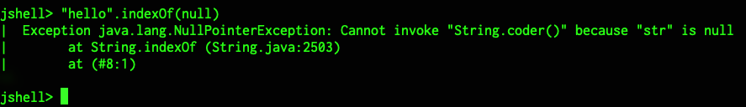
Who enforces preconditions?
Sometimes preconditions are enforced by some other mechanism.
str.indexOf(null) doesn't work, so String.indexOf(String str) has a precondition that str is not null.
The programmer of indexOf decided it was OK to let Java throw a NullPointerException to "enforce" the precondition.
Depending on the situation, it may or may not make sense to enforce preconditions in code... but they definitely should be documented.

Slide 27
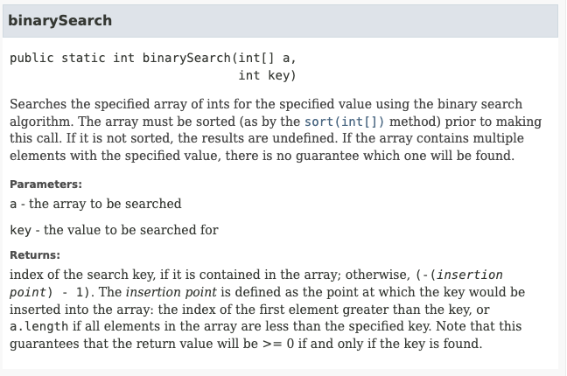
Who enforces preconditions?
At other times, it is not reasonable for the method to enforce the precondition.
The programmer calling the method must understand the preconditions and satisfy them.
The precondition here exists only as documentation, and describes the consequences of failing to meet it. (Where is the precondition?)

Slide 28
Postconditions
A postcondition is a condition that is true after running the method. It is what the method promises to do.
Postconditions describe the outcome of running the method, for example what is being returned or the changes to the instance variables.
Examples:
String.compareTo() The method returns 0 if the string is equal to the other string. A value less than 0 is returned if the string is less than the other string (less characters) and a value greater than 0 if the string is greater than the other string (more characters).
Math.random Returns a double value with a positive sign, greater than or equal to 0.0 and less than 1.0.

Slide 29
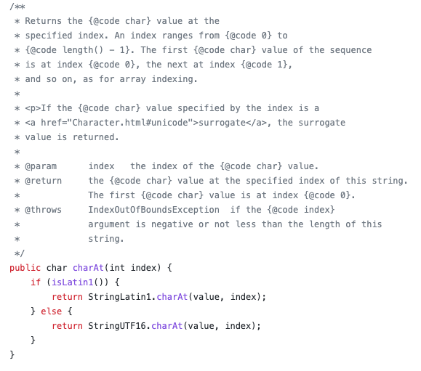
Javadoc
Documentation for Java code is often written as documentation comments, and then HTML is generated with a tool called javadoc.
Code and documentation used to be written separately... the idea of doc comments is that if the doc is with the code, it's less likely to be stale.
The javadoc often describe a method's preconditions and postconditions.

Slide 30
5.4 & 5.5
Accessor Methods
and Mutator Methods

Slide 31
Creating Classes (recap)
Instance Variables & Methods
Public vs Private
Constructors
Accessor Methods
Mutator Methods
Instance Variables (a.k.a attributes, properties, fields) hold the data of an Object and Instance Methods define the behaviors of an Object
public instance variables and methods are accessible from outside an Object
private instance variables and methods are only accessible from within the Object
Constructors define how a Class is initialized when it is created with new

Slide 32
Creating Classes
Variables & Methods
Public vs Private
Constructors
Accessor Methods
Mutator Methods
public methods used to provide read-only access to private instance variables within the Object
Sometimes these are called "get methods" or "getters"
These public methods have a return type that matches the type of the private variable being returned

Slide 33
Creating Classes
Accessor methods are commonly named get+VariableName and do not have parameters
public class Person
{
private String name;
public Person(String initName) {
name = initName;
}
public String getName() {
return name;
}
}
Variables & Methods
Public vs Private
Constructors
Accessor Methods
Mutator Methods

Slide 34
Creating Classes
Accessor methods can also return a filtered or transformed private variable value
public class Person
{
private String phoneNumber;
public String getAreaCode() {
return phoneNumber.substring(0,3);
}
}
Variables & Methods
Public vs Private
Constructors
Accessor Methods
Mutator Methods

Slide 35
Creating Classes
Variables & Methods
Public vs Private
Constructors
Accessor Methods
Mutator Methods
public methods used to modify internal private instance variables
Sometimes these are called "set methods" or "setters"
These public methods typically have a void return type and a parameter that matches the type of the private instance variable being modified

Slide 36
Creating Classes
Mutator methods are commonly named set+VariableName and have a single parameter
public class Person
{
private String name;
public Person(String initName) {
name = initName;
}
public String getName() {
return name;
}
public void setName(String newName) {
name = newName;
}
}
Variables & Methods
Public vs Private
Constructors
Accessor Methods
Mutator Methods

Slide 37
Creating Classes
Variables & Methods
Public vs Private
Constructors
Accessor Methods
Mutator Methods
Mutator methods can also filter, verify, or transform a value before assigning it to a private instance variable value
public class Person
{
private String areaCode;
public void setAreaCode(String phoneNumber) {
areaCode = phoneNumber.substring(0,3);
}
}

Slide 38
5.6: Writing Methods

Slide 39
Methods
We have already covered about HOW to create Methods - but we have not spent much time talking about WHEN you should consider moving code into a Method
Some of the WHENs
You have the same (or very nearly the same) block of code written in multiple places
You want to reduce complexity (improve development velocity / reduce code brittleness)
You want to write tests for a block of code
You have Methods that are excessively long (more than a single page)

Slide 40
Methods: Repeated Code
public class Person { private String firstName; private String lastName;
public Person(String fn, String ln) { firstName = fn; lastName = ln; }
public void sayHello() { String fullName = firstName + " " + lastName; System.out.println("Hello " + fullName); }
public void sayGoodbye() { String fullName = firstName + " " + lastName; System.out.println("Goodbye " + fullName); } }
public class Person { private String firstName; private String lastName;
public Person(String fn, String ln) { firstName = fn; lastName = ln; }
public void sayHello() { System.out.println("Hello " + fullName()); }
public void sayGoodbye() { System.out.println("Goodbye " + fullName()); }
private String fullName() { return firstName + " " + lastName; } }

Slide 41
Methods: Reduce Complexity
public class FenceMaintenance {
private int fenceWidth, fenceHeight;
public FenceMaintenance(int width, int height) {
fenceWidth = width; fenceHeight = height;
}
public paintFence() {
int paintBucketsNeeded = (fenceWidth * fenceHeight) / 10;
int brushesNeeded = paintBucketsNeeded * 1.5;
double totalCost = 1.50 * brushesNeeded;
totalCost += 12.99 * paintBucketsNeeded;
System.out.println("Supplies purchased for $" + totalCost);
int totalTime = fenceArea / 5;
System.out.println("Time required is " + totalTime + "minutes.");
}
}
public class FenceMaintenance {
private int fenceWidth, fenceHeight; public FenceMaintenance(int width, int height) {
fenceWidth = width; fenceHeight = height;
}
public paintFence() {
System.out.println("Supplies purchased for $" + calcCosts());
System.out.println("Time required is " + calcTimeNeeded() + "minutes.");
} private int calcPaintBucketsNeeded() { return calcFenceArea() / 10;
} private int calcFenceArea() { return fenceWidth * fenceHeight;
}
private int calcBrushesNeeded() { return calcPaintBucketsNeeded() * 1.5;
} private int calcTimeNeeded() { return calcFenceArea() / 5;
}
private double calcCosts() { return calcBrushesNeeded() * 1.50 + calcPaintBucketsNeeded() * 12.99;
} }

Slide 42
Method Parameters: Pass by Value / Pass by Reference
Parameters passed into Methods behave differently if they are primitive types or Object references
Primitive Types (byte, short, int, long, float, double, boolean, char)
A copy is made when the Method is invoked for use during the life of the Method
The Method cannot alter the value of the variable (passed as a parameter) that exists in the caller of the Method
int age = 16; Person p = new Person(age); // age is guaranteed to still be 16 public class Person { public Person(int initAge) { // initAge is a COPY of age initAge = 20; // does not alter the value of age in the caller } }
int
age
16
int
Person.Person() {
initAge
20
}

Slide 43
Method Parameters: Pass by Value / Pass by Reference
Object Types / Classes
A reference to the Object is passed into the Method
The Method can alter the internal value of the Object passed as a parameter; And the caller can see these changes when it access the Object
int age = 16; Person p = new Person(age); // p.age == 16 Student s = new Student(p); // p.age == 20 public class Student { public Student(Person person) { // person is a REFERENCE to the same object in the caller person.age = 20; // alters the Person passed in from the the caller } }
Person
p
age: 20
Student.Student() {
person
}

Slide 44
Method Parameters: Pass by Value / Pass by Reference
Object Types / Classes
A reference to the Object is passed into the Method
The Method can alter the value of the variable (passed as a parameter) that exists in the caller of the Method - RARELY USED / NOT A BEST PRACTICE
Person p = new Person(); p.age = 16; Student s = new Student(p); // p.age now equals 20 - LIKELY UNEXPECTED BEHAVIOR public class Student { public Student(Person person) { // person is a REFERENCE to the same object in the caller person.age = 20; // alters the Person passed in from the the caller } }

Slide 45
Sections 5.7, 5.8, 5.9
Statics
Scope and Access
this

Slide 46
Statics
Static variables & methods belong to Classes - not Instances of a Class
There is only one copy of a static variable & method
They can be public or private
Static variables & methods are accessed using the name of the class to which they belong and a dot (.) With a couple of exceptions: Statics accessing statics; And static imports
Math.PI
Math.random()
Math.sqrt()
The main() method is a static method - It is only ever run one time for a program - And the JVM needs to run it without creating an Instance of a Class

Slide 47
Statics
Person.getNumPeople(); A> 0
Statics can directly access other Statics
Statics cannot directly access non-Statics
Non-Statics can directly access Statics
class Person { private static int numPeople = 0; private String name; public Person(String initName) { numPeople++; name = initName; } public static int getNumPeople() { // System.out.println(name); return numPeople; } public void report() { System.out.println(name + " is one of " + numPeople + " people"); } }

Slide 48
Statics
public static int getNumPeople() { // System.out.println(name); return numPeople; }
Statics can directlyaccess other Statics
Statics cannot directly access non-Statics
Non-Statics can directly access Statics
class Person { private static int numPeople = 0; private String name; public Person(String initName) { numPeople++; name = initName; } public static int getNumPeople() { // System.out.println(name); return numPeople; } public void report() { System.out.println(name + " is one of " + numPeople + " people"); } }

Slide 49
Statics
Person p1 = new Person("Julie"); Person p2 = new Person("Bobby"); p1.report() B> Julie is one of 2 people
p1.getNumPeople();
C> 2
Statics can directly access other Statics
Statics cannot directly access non-Statics
Non-Statics can directly access Statics
class Person { private static int numPeople = 0; private String name; public Person(String initName) { numPeople++; name = initName; } public static int getNumPeople() { // System.out.println(name); return numPeople; } public void report() { System.out.println(name + " is one of " + numPeople + " people"); } }

Slide 50
Scope and Access Control
Scope of a variable is where a variable can be accessed and used
Determined by where the variable is declared in the program and can be found by looking at the closest curly brackets
Class Level Scope Instance and static variables inside a Class
Method Level Scope Local variables (including parameter variables) inside a method
Block Level Scope Loop variables and other local variables defined inside of blocks of code with {}

Slide 51
Scope and Access Control
Class Level Scope Instance and static variables inside a Class.
Method Level Scope Local variables (including parameter variables) inside a method.
Block Level Scope Loop variables and other local variables defined inside of blocks of code with { }
public class Person { private String name;
private String email; public void print(int length) { for (int i = 0; i < length; i++) { System.out.println(name.charAt(i)); } } }

Slide 52
Scope and Access Control
Class Level Scope Instance and static variables inside a Class.
Method Level Scope Local variables (including parameter variables) inside a method.
Block Level Scope Loop variables and other local variables defined inside of blocks of code with { }
public class Person { private String name;
private String email; public void print(int length) { for (int i = 0; i < length; i++) { System.out.println(name.charAt(i)); } } }

Slide 53
Scope and Access Control
Class Level Scope Instance and static variables inside a Class.
Method Level Scope Local variables (including parameter variables) inside a method.
Block Level Scope Loop variables and other local variables defined inside of blocks of code with { }
public class Person { private String name;
private String email; public void print(int length) { for (int i = 0; i < length; i++) { System.out.println(name.charAt(i)); } } }

Slide 54
Scope and Access Control
EXTREMELY easy to make an error in your Constructor with parameter and instance variable names.
We have been using initAge and initName (as parameter names) to disambiguate between age and name instance variables.
But now we can start using...
public class Person { private int age = 10;
public Person(int age) {
age = 20;
}
public int getAge() {
return age;
} public void loopTest(int age) {
int age = 30; if (true) { int age = 40; age = 50; } age = 60;
} }
Which variables have
Class Level Scope
Method Level Scope
Block Level Scope
Which age variable is referenced at
A
B
C
D
A
B
C
D

Slide 55
this (keyword)
Within an Instance method of a Class - this refers to the current Instance (and refers to the Instance being created in a Constructor)
Static methods cannot refer to this (since there is no Instance when using static methods)
class Person { private static int numPeople = 0; private String name; public Person(String name) { numPeople++; this.name = name; } public static int getNumPeople() { return numPeople; } public void report() { System.out.println(name + " is one of " + numPeople + " people"); } }

